Slide 1

CRSS (PBGG) 8010:
Research Methods and Design in Crop Science
Jason Wallace Fall 2026
Lecture 19
Repeated Measures
Notes:
Shortened this in 2026 since both previous times it ran long

Slide 2
Lecture outline
Administrative stuff
Review
Combining Data
Repeated Measures

Slide 3
Administrative Stuff
Midterm 2 starts next Thursday after class

Slide 4
Review:
Random versus fixed effects
Would the following be best coded as fixed or random?
  6 soybean varieties you’re testing for potential cultivar release
  4 irrigation regimes for watermelon
  Fields used for replicated experiments in Tifton, Plains, and Midville
  The 4 grad students who scored gray leaf spot disease severity on maize
  5 fields used every year for statewide variety testing for cotton
    To gauge varieties for farmers to use
    To determine the relative quality of each field

Slide 5
Review:
Random versus fixed effects
Would the following be best coded as fixed or random?
  6 soybean varieties you’re testing for potential cultivar release
  4 irrigation regimes for watermelon
  Fields used for replicated experiments in Tifton, Plains, and Midville
  The 4 grad students who scored gray leaf spot disease severity on maize
  5 fields used every year for statewide variety testing for cotton
    To gauge varieties for farmers to use
    To determine the relative quality of each field
Fixed
Random
Notes:
Again, there can be some debate about some of these. The answers I’ve given are the most likely ones to be used (in my opinion), but you could probably make an argument to use the other one in some circumstances

Slide 6
Review:
Split Plot
Download “19_organicmatter.csv”, which is a split plot experiment comparing the effect of 3 tillage methods and 5 cover crops on soil organic matter
  Whole-plots in RCBD
  Remember syntax for random effects: “(1|name)”
  Use anova() to test the fixed effects and ranova() to test the random effects

Slide 7
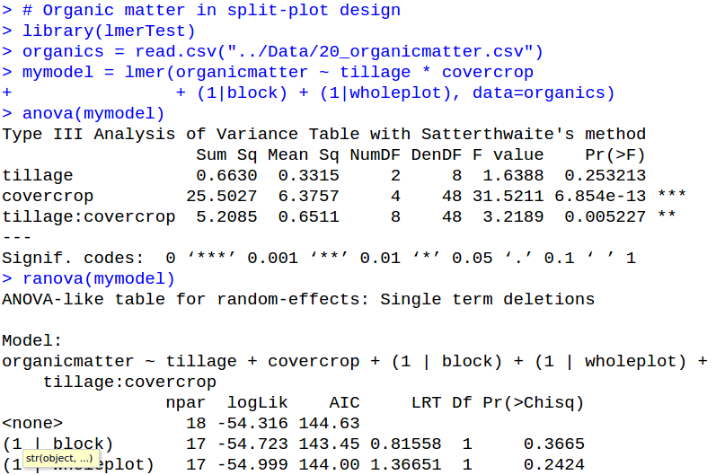
Review:
Split Plot
Note: Order of Fixed versus Random effects doesn’t matter. (I usually put random effects last, but that’s just preference.)

Slide 8
Review:
Split Plot
Fixed effects

Slide 9
Review:
Split Plot
Random effects
Notes:
We haven’t talked about ranova() before, but it’s a convenience function to get an ANOVA-like analysis for random effects. (notice the different column headings though; it’s a different math going on under the hood, but for end users we generally just care about the significance)

Slide 10
Questions on last time’s material?

Slide 11
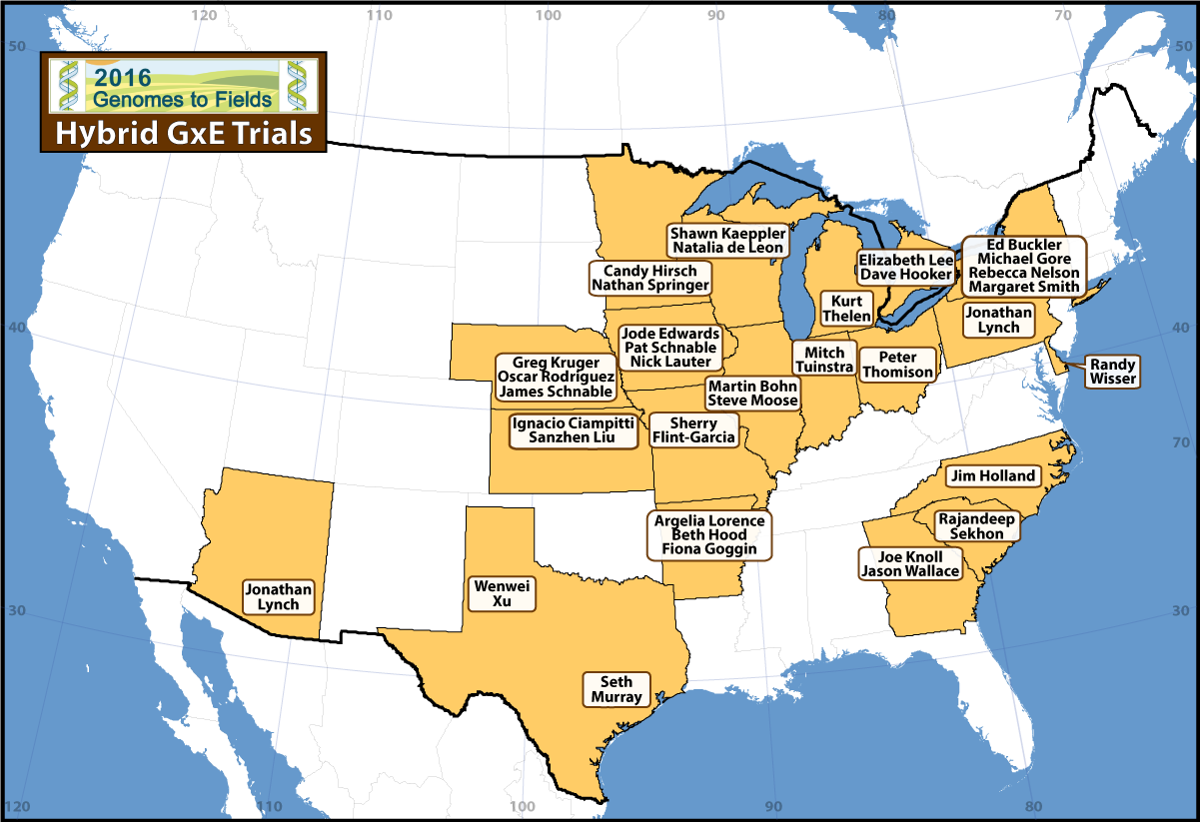
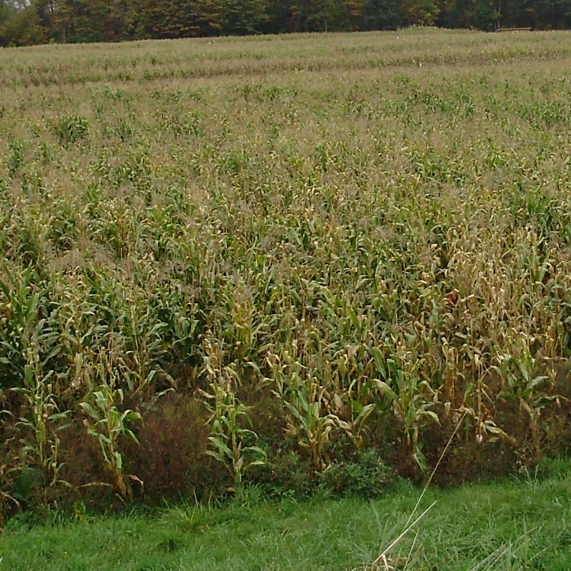
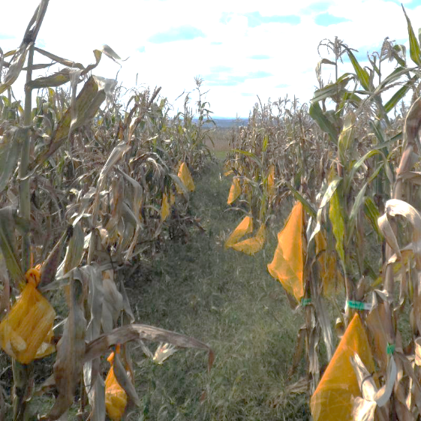
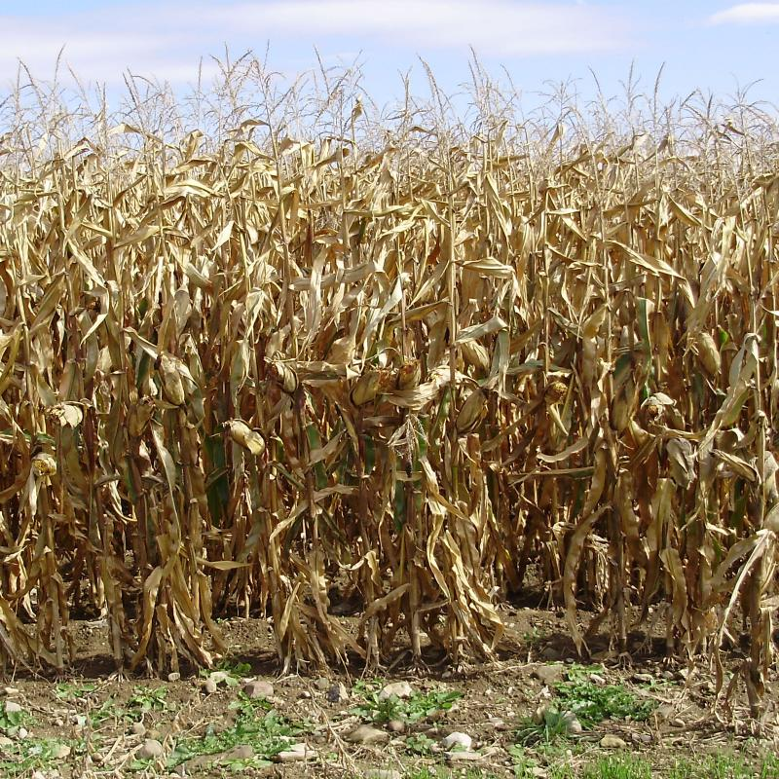
Combining data
Often we have data from multiple sources
Locations
Years
30 locations across the US
2024
2025
2026
Genomes2fields.org

Slide 12
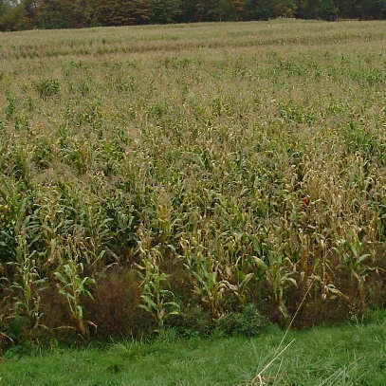


How to combine data
Can combine in Excel, but no record of what you did
Recommend instead using R, with choice of:
  rbind()
  bind_rows()

Slide 13
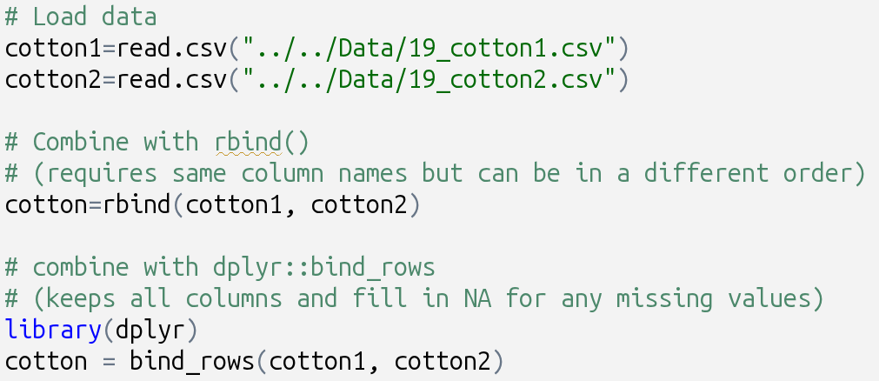
Combining data in R

Slide 14
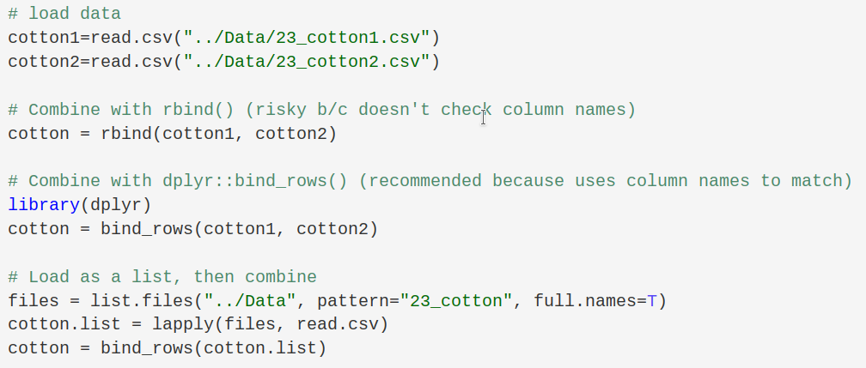
Combining data in R
Bonus functions
list.files() – List all files in a specified directory
  Can also specify patterns to look for
lapply() – apply a function to each item in a list
  Returns a list of the results

Slide 15
Questions on how to merge data frames?

Slide 16
Environment as a superblock
When combined data has multiple blocks per location, environment becomes a superblock
Tifton
Plains
Midville
A | E
D | B
F | C
B | C
A | F
E | D
F | B
E | C
A | D
D | F
C | A
B | E
E | D
F | A
C | B
D | E
B | F
C | A
D | E
A | B
C | F
B | C
E | F
D | A
B | F
E | A
C | D

Slide 17
Environment as a superblock
Same applies across years
Tifton 2025
Plains 2025
Midville 2025
A | E
D | B
F | C
B | C
A | F
E | D
F | B
E | C
A | D
D | F
C | A
B | E
E | D
F | A
C | B
D | E
B | F
C | A
D | E
A | B
C | F
B | C
E | F
D | A
B | F
E | A
C | D
Tifton 2026
Plains 2026
Griffin 2026
D | E
B | F
C | A
B | C
E | F
D | A
B | F
E | A
C | D
F | B
E | C
A | D
A | E
D | B
F | C
D | F
C | A
B | E
E | D
F | A
C | B
B | C
A | F
E | D
D | E
A | B
C | F

Slide 18
How to treat superblocks?
Two options:
  Treat them as their own variable to analyze
  Let their variance be absorbed by the smallest block possible (my preference)
Tifton 2026
Plains 2026
Griffin 2026
D | E
B | F
C | A
B | C
E | F
D | A
B | F
E | A
C | D
F | B
E | C
A | D
A | E
D | B
F | C
D | F
C | A
B | E
E | D
F | A
C | B
B | C
A | F
E | D
D | E
A | B
C | F

Slide 19
Treatment option 1:
Treat superblocks as their own variable
Year:
Tifton 2025
Plains 2025
Midville 2025
A | E
D | B
F | C
B | C
A | F
E | D
F | B
E | C
A | D
D | F
C | A
B | E
E | D
F | A
C | B
D | E
B | F
C | A
D | E
A | B
C | F
B | C
E | F
D | A
B | F
E | A
C | D
2025
Tifton 2026
Plains 2026
Griffin 2026
D | E
B | F
C | A
B | C
E | F
D | A
B | F
E | A
C | D
F | B
E | C
A | D
A | E
D | B
F | C
D | F
C | A
B | E
E | D
F | A
C | B
B | C
A | F
E | D
D | E
A | B
C | F
2026
Location:
Tifton
Plains
Midville
Griffin

Slide 20
Treatment option 1:
Treat superblocks as their own variable
Tifton
Plains
Midville
A | E
D | B
F | C
B | C
A | F
E | D
F | B
E | C
A | D
D | F
C | A
B | E
E | D
F | A
C | B
D | E
B | F
C | A
D | E
A | B
C | F
B | C
E | F
D | A
B | F
E | A
C | D
2025
Griffin
D | E
B | F
C | A
B | C
E | F
D | A
B | F
E | A
C | D
F | B
E | C
A | D
A | E
D | B
F | C
D | F
C | A
B | E
E | D
F | A
C | B
B | C
A | F
E | D
D | E
A | B
C | F
2026
Does this look familiar?
Notes:
Laid out like this, these begin to look very much like strip plots.

Slide 21
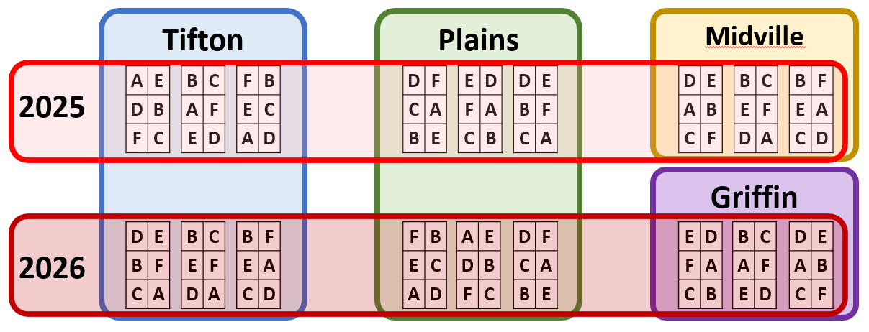
Treatment option 1:
Treat superblocks as their own variable
Looks complex, but easy to set up
Give each factor its own column
  Year
  Location
  Block
  Etc.
Year | Location | Block | Variety | Yield
2015 | Tifton | Tift15_1 | A | 16.1
2016 | Tifton | Tift16_2 | C | 12.2
2015 | Plains | Plain15_1 | A | 13.4
2015 | Midville | Mid15_3 | B | 11.5
2016 | Griffin | Griff16_2 | B | 12.6
Notes:
In general, you’re safer to treat both locations and years as random effects. You can make arguments for fixed effects, of course, if there’s something that interests you about these specific years and locations. (Usually there isn’t.)

Slide 22
Treatment option 2:
Break everything down to the smallest possible block
Usually don’t care about location, year, etc.
  =“nuisance variables”
As such, you can break everything down to the smallest possible block and let those absorb all variance

Slide 23
Treatment option 1:
Treat superblocks as their own variable
Tifton
Plains
Midville
A | E
D | B
F | C
B | C
A | F
E | D
F | B
E | C
A | D
D | F
C | A
B | E
E | D
F | A
C | B
D | E
B | F
C | A
D | E
A | B
C | F
B | C
E | F
D | A
B | F
E | A
C | D
2025
Griffin
D | E
B | F
C | A
B | C
E | F
D | A
B | F
E | A
C | D
F | B
E | C
A | D
A | E
D | B
F | C
D | F
C | A
B | E
E | D
F | A
C | B
B | C
A | F
E | D
D | E
A | B
C | F
2026

Slide 24
Treatment option 2:
Break everything down to the smallest possible block
Tift25_1
Tift25_2
Tift25_3
Plains25_1
Plains25_2
Plains25_3
Mid25_1
Mid25_2
Mid25_3
A | E
D | B
F | C
B | C
A | F
E | D
F | B
E | C
A | D
D | F
C | A
B | E
E | D
F | A
C | B
D | E
B | F
C | A
D | E
A | B
C | F
B | C
E | F
D | A
B | F
E | A
C | D
Tift26_1
Tift26_2
Tift26_3
Plains26_1
Plains26_2
Plains26_3
Griff26_1
Griff26_2
Griff26_3
D | E
B | F
C | A
B | C
E | F
D | A
B | F
E | A
C | D
F | B
E | C
A | D
A | E
D | B
F | C
D | F
C | A
B | E
E | D
F | A
C | B
B | C
A | F
E | D
D | E
A | B
C | F
Notes:
Here instead of having 4 location blocks crossed with 2 year blocks and each having 3 rep blocks inside them, we just have 18 rep blocks that happen to be located at different times and locations

Slide 25
Treatment option 2:
Break everything down to the smallest possible block
Using individual blocks works because each block’s effect is the sum of
  The year effect
  The location effect
  Anything else influencing it (soil quality, etc.)
Including the year & location in the model partitions the SS into its separate sources but doesn’t change the total
A | E
D | B
F | C
B | C
A | F
E | D
F | B
E | C
A | D
D | F
C | A
B | E
E | D
F | A
C | B
D | E
B | F
C | A
D | E
A | B
C | F
B | C
E | F
D | A
B | F
E | A
C | D
D | E
B | F
C | A
B | C
E | F
D | A
B | F
E | A
C | D
F | B
E | C
A | D
A | E
D | B
F | C
D | F
C | A
B | E
E | D
F | A
C | B
B | C
A | F
E | D
D | E
A | B
C | F
Notes:
Since we generally only care about blocks (and years and locations) for their ability to absorb error, it doesn’t matter how the variance is partitioned, really. Keeping it to individual blocks is less error-prone

Slide 26
A reminder about notation
Year | Location | Block | Variety | Yield
2025 | Tifton | Tift25_1 | A | 16.1
2026 | Tifton | Tift26_2 | C | 12.2
2025 | Plains | Plain25_1 | A | 13.4
2025 | Midville | Mid25_3 | B | 11.5
2026 | Griffin | Griff26_2 | B | 12.6
Notice how I named each block uniquely
Things that are different should be named differently
Location + Year + Number
(could have done “b1”,”b2”, to “b18”, but this is easier for me to remember)

Slide 27
R code: Assembling labels
Your best tool for this is paste()
  > block_unique=paste(location, year, block, sep=“_”)
location
Tifton
Tifton
Plains
Midville
Griffin
year
2025
2026
2025
2025
2026
block
1
2
1
3
2

Slide 28
R code: Assembling labels
Your best tool for this is paste()
  > block_unique=paste(location, year, block, sep=“_”)
vectors to be pasted
location
Tifton
Tifton
Plains
Midville
Griffin
year
2025
2026
2025
2025
2026
block
1
2
1
3
2

Slide 29
R code: Assembling labels
character to separate with
Your best tool for this is paste()
  > block_unique=paste(location, year, block, sep=“_”)
vectors to be pasted
location
Tifton
Tifton
Plains
Midville
Griffin
year
2025
2026
2025
2025
2026
block
1
2
1
3
2
block_unique
Tifton_2025_1
Tifton_2026_2
Plains_2025_1
Midville_2025_3
Griffin_2026_2
Notes:
The “sep” argument defaults to “ “ (space) and can be set to “” (empty string) if you don’t want anything to separate them.
An alternative is paste0(), which is exactly the same except the default separator is “” (meaning nothing)

Slide 30
Fitting the model
When fitting the model, use either option 1 or option 2, but not both because they’re redundant
Option 1 - Separate
Option 2 - Combined
location
Tifton
Tifton
Plains
Midville
Griffin
year
2025
2026
2025
2025
2026
block
1
2
1
3
2
block_unique
Tifton_2025_1
Tifton_2026_2
Plains_2025_1
Midville_2025_3
Griffin_2026_2
Notes:
The “sep” argument defaults to “ “ (space) and can be set to “” (empty string) if you don’t want anything to separate them.

Slide 31

Exercise:
Combining Data
Load the 4 datasets starting with “19_tortillas”, which are trials of maize around Georgia for tortilla making quality
Merge the data, then analyze it:
  By keeping the blocking factors separate
  By using the smallest possible blocks
Compare the results from the two models

Slide 32
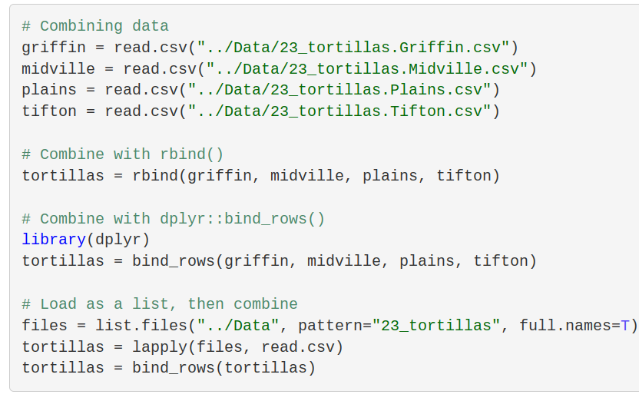
Exercise:
Combining data
Three possible solutions

Slide 33
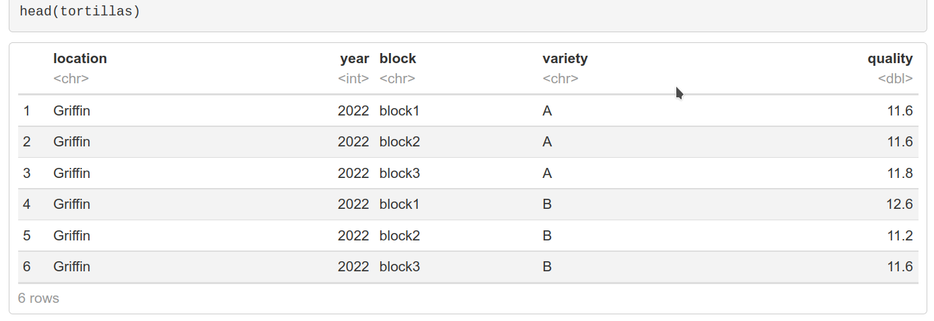
Exercise:
Combining data
Dangerous – Loaded as Int instead of Character

Slide 34
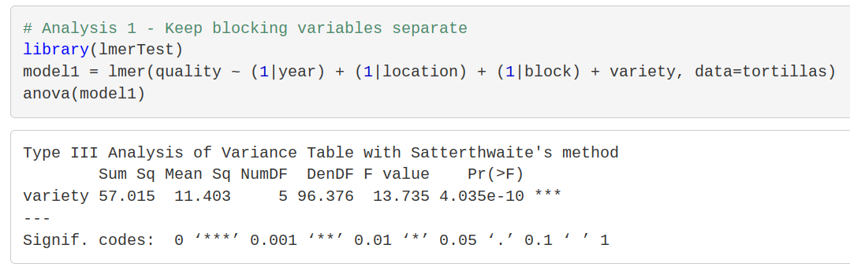
Exercise:
Combining data

Slide 35
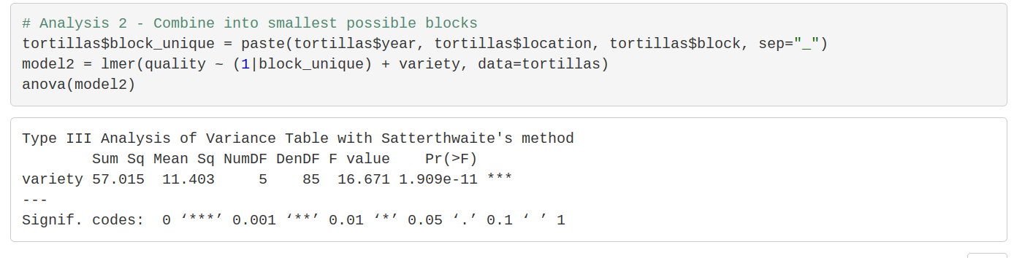
Exercise:
Combining data
Not quite the same due to approximation methods, but very close

Slide 36
Questions on merging data?

Slide 37
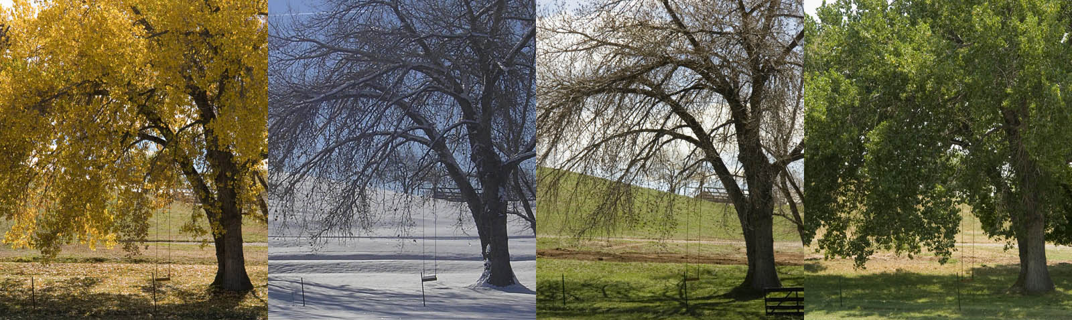
Repeated Measures
The previous examples assumed we were setting up new experiments every year
Sometimes we want to measure things more than once:
  Multiple timepoints over the season
  Multiple years of perennial crops
  Before/after specific treatments
  Etc…
My91YearOldMom.com
Notes:
Repeated measures can be a more effective use of resources than replanting each year, or it could just be intrinsic to the system you’re looking at.

Slide 38
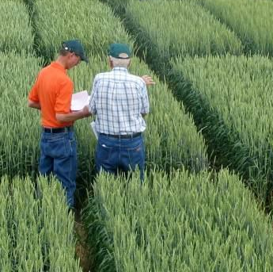
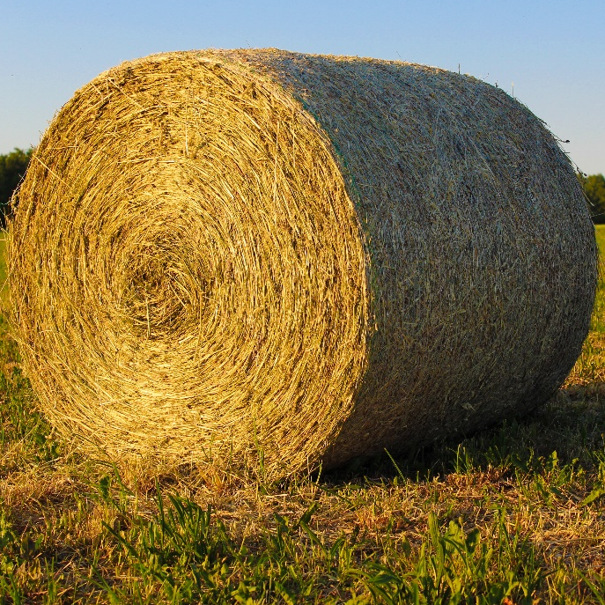
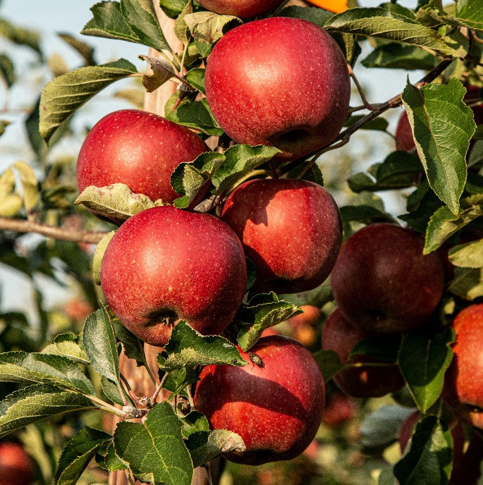
Issue of Repeated Measures
What is the problem when we measure:
5 subsamples/plot
3 times/year
Each year for 5 years
Data points are not independent!
AgriNews
Notes:
Repeated measures can be a more effective use of resources than replanting each year, or it could just be intrinsic to the system you’re looking at.

Slide 39
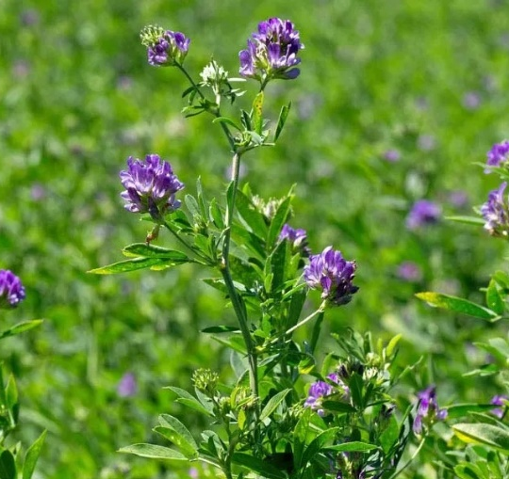
Repeated Measures Exercise:
Alfalfa harvest
Load 19_alfalfa.csv, which has data for 4 alfalfa
varieties evaluated for forage yield & quality
  RCBD with 4 reps
  3 harvests per year
  3 years of data
Analyze this as best as you can to see if the varieties are different from each other.
  Note: You have the tools to do this properly, but we haven’t used them like this before (=desirable difficulty).
Notes:
Rather than go over this, I want you to try to figure out how to do it. This is one of the “desirable difficulties”, because trying to find an answer like this makes you remember the actual answer better when you get it (either on your own or from the instructor)

Slide 40
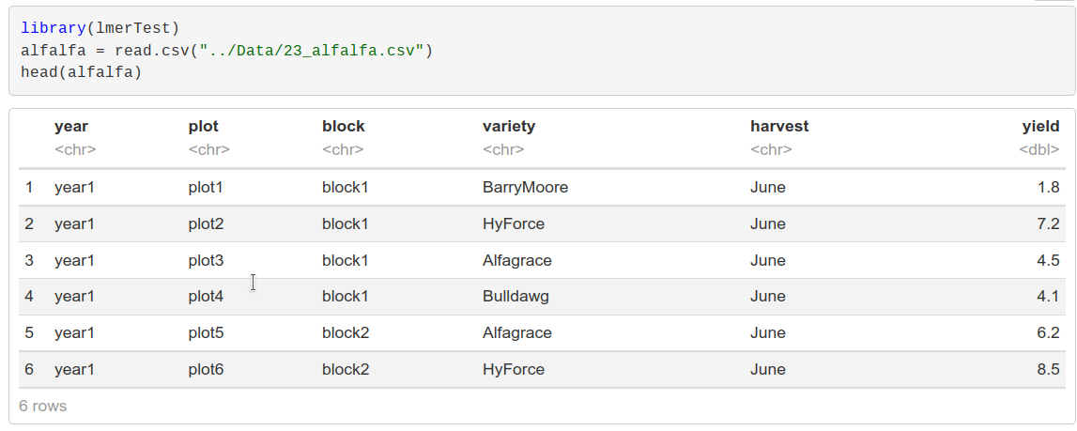
Repeated Measures Exercise:
Alfalfa harvest
Load data

Slide 41
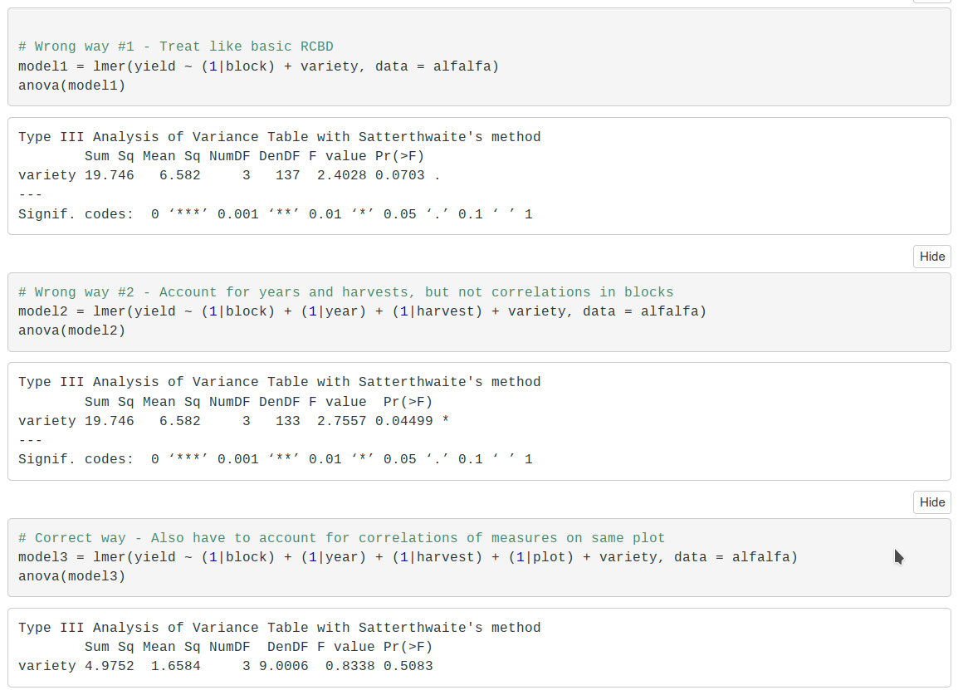
Repeated Measures Exercise:
Alfalfa harvest
INCORRECT way #1 – Treat as RCBD

Slide 42
Repeated Measures Exercise:
Alfalfa harvest
INCORRECT way #2 – Account for just year and harvest

Slide 43
Repeated Measures Exercise:
Alfalfa harvest
CORRECT way – Account for year, harvest, AND plots

Slide 44
Repeated Measures Exercise:
Alfalfa harvest
The correct method basically turns it into a split-plot experiment:
Superplot | Subplot | Sub-subplot | Sub-sub-subplot
Year | Harvest | Plot | Individual datapoint
Just like all plots within a superplot are correlated, all measurements from the same plot will be correlated

Slide 45
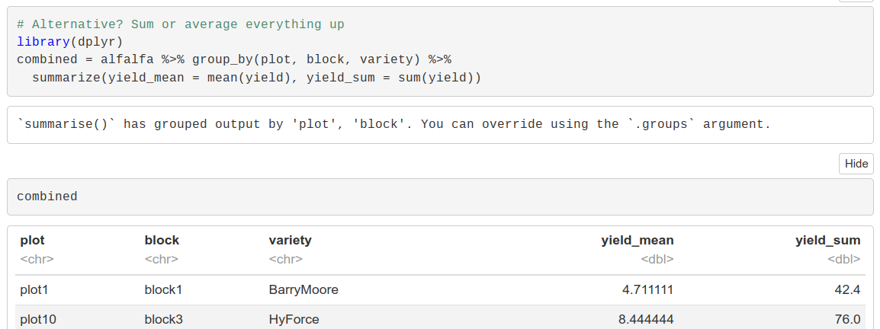
Repeated Measures Exercise:
Alfalfa harvest
ALTERNATIVE way – Combine all data
Grouping Factors (=what to summarize by; also what we want to keep)
Make summaries based on mean yield and on total yield

Slide 46
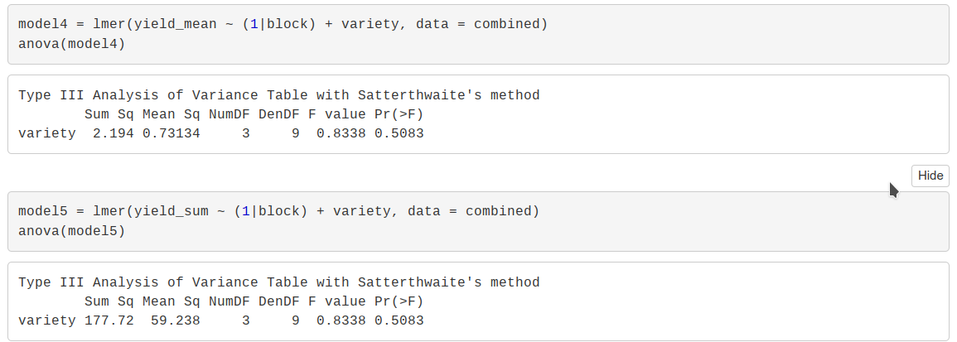
Repeated Measures Exercise:
Alfalfa harvest
ALTERNATIVE way – Combine all data
Same p-value as mixed model

Slide 47
So why go through all that trouble?
If taking the sum or mean value gives the same P-value with a simpler model, why use repeated measures?
Reason 1
You care about some of the blocking effects (harvest, year, etc.)
Reason 2
Missing data!
When everything balanced, the sum/average value include the same effects for everything (yield, harvest, etc.)
With missing data, some values lack those effects, skewing the result

Slide 48
Questions on repeated measures?

Slide 49
Versatility of random effects
We’ve been using random effects to cover a lot of things
  Blocks in RCBD, plus other designs coming up (optional)
  Superplots in strip/split plots (required)
  Repeated measures (required)
  Etc.
What do these have in common?
  Specifically, in terms of how they affect our data?
  They all create correlated responses

Slide 50
Correlated errors
When something creates correlations in our data,
it means the errors are not random
This violates the assumptions of linear regression:
Linear regression assumptions:
Linear relationship between dependent and independent variables
No multicollinearity
Residuals are normally distributed
Residuals are uncorrelated
Homoscedasticity

Slide 51
Correlated errors
When something creates correlations in our data,
it means the errors are not random
This violates the assumptions of linear regression:
Linear regression assumptions:
Linear relationship between dependent and independent variables
No multicollinearity
Residuals are normally distributed
Residuals are uncorrelated
Homoscedasticity

Slide 52
Random effects deal with correlation
Random effects let you estimate a “covariance” structure for the items in your model
  (We’ve let this happen invisibly by R)
This lets you account for correlations among data points
  Also spatial effects, genetic relatedness, and many others outside the scope of this class

Slide 53
Random effects deal with correlation
So now we have a general rule:
If something in your experiment creates correlations among data points, analyze it as a random effect
(Note: this mostly applies to nuisance variables. For treatments, use your best judgment)

Slide 54
Questions on random effects?

